Slide 1


Introduction to PHP
Web technologies: PHP
Notes:
© SUPINFO International University - http://www.supinfo.com
SUPINFO vous permet de partager ce document
Vous êtes libre de :
Partager — reproduire, distribuer et communiquer ce document Remixer — modifier ce document
A condition de respecter les règles suivantes :
Indication obligatoire de la paternité — Vous devez obligatoirement préciser l’origine « SUPINFO » du document au début de celui-ci de la même manière qu’indiqué par SUPINFO International University – Notamment en laissant obligatoirement la première et la dernière page du document, mais pas d'une manière qui suggérerait que SUPINFO International University vous soutiennent ou approuvent votre utilisation du document, surtout si vous le modifiez. Dans ce dernier cas, il vous faudra obligatoirement supprimer le texte « SUPINFO Official Document » en tête de page et préciser notamment la page indiquant votre identité et les modifications principales apportées.
En dehors de ces dispositions, aucune autre modification de la première et de la dernière page du document n’est autorisée.
NOTE IMPORTANTE : Ce document est mis à disposition selon le contrat CC-BY-NC-SA Creative Commons disponible en ligne http://creativecommons.org/licenses ou par courrier postal à Creative Commons, 171 Second Street, Suite 300, San Francisco, California 94105, USA modifié en ce sens que la première et la dernière page du document ne peuvent être supprimées en cas de reproduction, distribution, communication ou modification. Vous pouvez donc reproduire, remixer, arranger et adapter ce document à des fins non commerciales tant que vous respectez les règles de paternité et que les nouveaux documents sont protégés selon des termes identiques. Les autorisations au-delà du champ de cette licence peuvent être obtenues à support@supinfo.com.
© SUPINFO International University – EDUCINVEST - Rue Ducale, 29 - 1000 Brussels Belgium . www.supinfo.com

Slide 2

Course objectives
Introduction to PHP
By completing this course, you will be able to:
Explain how PHP was created
Explain what the dynamic Web is
Install PHP

Slide 3


Course plan
Introduction to PHP
Web technologies reminders
Dynamic Web with PHP
Tools

Slide 4
Web technologies reminders
Introduction to PHP

Slide 5


Internet
Web technologies reminders
Public worldwide computer network system
Use the standard Internet Protocol Suite (TCP/IP)
Network of networks
Public access to many resources and services

Slide 6

World Wide Web (WWW)
Web technologies reminders
Commonly known as the Web
Interlinked hypertext documents accessed via the Internet
May contain texts, images, videos, etc

Slide 7

The W3C
Web technologies reminders
World Wide Web Consortium
Normalization organism created in 1994
Managed by MIT, ERCIM and Keio university
Creates standards to ensure web technologies compatibility
More information: http://www.w3c.org/

Slide 8

HTML: The Web language
Internet presentation
HyperText Markup Language
Used to format a document
Descriptive language
Hypertext concept
Easy to use
Light Format
Current version : HTML 4.01
Draft: HTML5

Slide 9
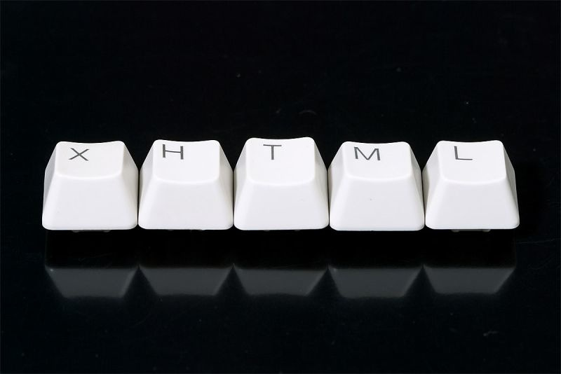
XHTML
Internet presentation
eXtensible HyperText Markup Language
XML Markup Language
HTML Extended version
Need to be well-formed
XML documents

Slide 10

CSS
Internet presentation
CSS: Cascading Style Sheet
Allows to design a HTML document
Separates design and content
Simplifies maintenance of web pages

Slide 11
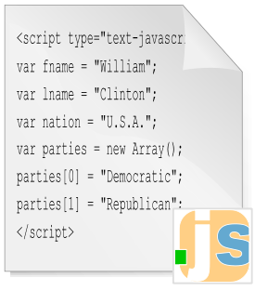
JavaScript
Internet presentation
Scripting language inspired by many languages, including Java and Python
Client side → Interpreted by web browser
Different from PHP

Slide 12
JavaScript
Internet presentation
Complementary to HTML and CSS
Add dynamism!
User Interactions
Animations
Navigation Help

Slide 13


Questions ?

Slide 14
Dynamic web with php
Introduction to PHP

Slide 15
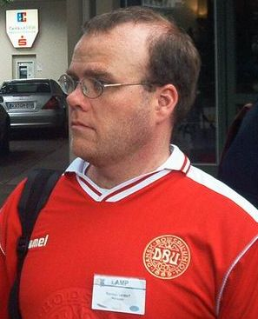
History of PHP
Dynamic Web with PHP
PHP originally stood for « Personal Home Page »
Invented in 1994 by Rasmus Lerdorf
Initially a set of Perl scripts to maintain his personal homepage

Slide 16
History of PHP
Dynamic Web with PHP
PHP originally stood for « Personal Home Page »
Renamed later in Personal Home Page/Forms Interpreter
First publication code in 1995

Slide 17
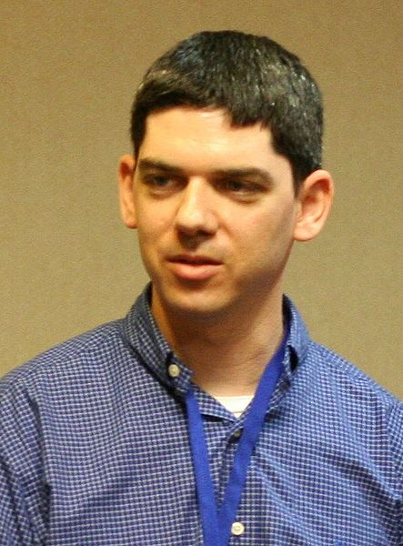
History of PHP
Dynamic Web with PHP
In 1997, Zeev Suraski and Andi Gutmans rewrote the parser
The base of PHP 3!
Language's name change to a recursive acronym:
PHP: PHP Hypertext Preprocessor
Andi Gutmans

Slide 18
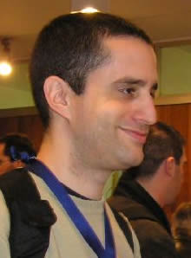
History of PHP
Dynamic Web with PHP
In 1999, creation of Zend Engine
Ze(ev) + (A)nd(y) = Zend
In 2004, release of PHP 5 with OOP support
Currently: 5.4.10 – January 2013
Zeev Suraski

Slide 19
Presentation
Dynamic Web with PHP
Server-side scripting language
Is executed before client receive the page
Server-side ≠ Client-side (JavaScript)
More secure because scripts are never visible to the client.

Slide 20
Presentation
Dynamic Web with PHP
Request a page
PHP executes page
Reception of request
Sends generated code
Loading of page
(Reply in HTML format)
Send page to PHP
Display of page

Slide 21
Questions ?

Slide 22
Tools
Introduction to PHP

Slide 23



Web Server
Tools
Apache
IIS
NginX
Lighttpd
…

Slide 24
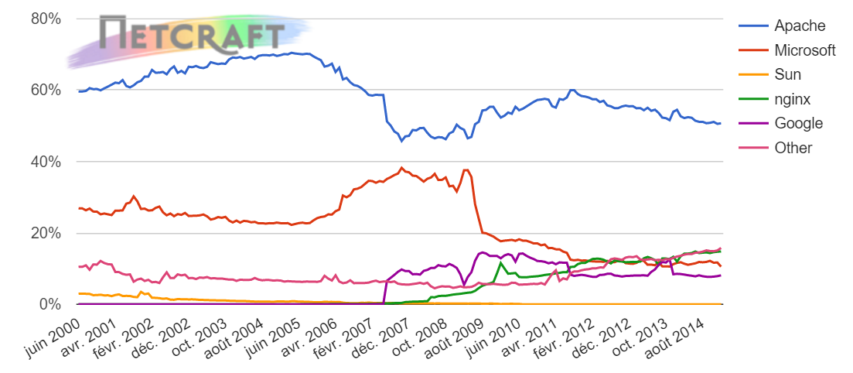
Usage share of Web Servers
Tools
Source: Netcraft

Slide 25




DB Server
Tools
MySQL
SQLite
Oracle
DB2
SQL Server
…

Slide 26



Automatic Setup
Tools
Apache, MySQL & PHP:
WAMP for Windows
MAMP for Mac OS
LAMP for Linux

Slide 27




Frameworks
Tools
PHP Frameworks:
Symfony
Zend
CakePHP
Code Igniter
…

Slide 28




IDE
Tools
PHP IDEs:
Eclipse for PHP
NetBeans for PHP
PHPStorm
Aptana Studio
…
Notes:
IDE: Integrated Development Environment

Slide 29
Questions ?

Slide 30

Exercise (1/3)
Tools
Dowload and install on your computer LAMP, WAMP or MAMP depending of your OS
Start the services
With your web browser:
Try to go to localhost
Try to go to phpMyAdmin

Slide 31
Exercise (2/3)
Tools
Download and install a source code editor depending of your OS
See Course presentation module for some
Download & install NetBeans for PHP
https://netbeans.org/features/php/

Slide 32
Exercise (3/3)
Tools
Check that it works!
Create a new PHP project
Store it in your WAMP/MAMP/LAMP www folder
Add some HTML tags in your index.php page to see a difference with the default page
Check that you can access your page:
WAMP/LAMP: http://localhost/yourfolder
MAMP: http://localhost:8888/yourfolder

Slide 33

The end
Introduction to PHP
Thanks for your attention

